Slide 1


Black Hole Solutions with Spacetime-Symmetry Breaking
By: Hailey Murray*
Embry-Riddle Aeronautical University
Mentor: Quentin Bailey

Slide 2

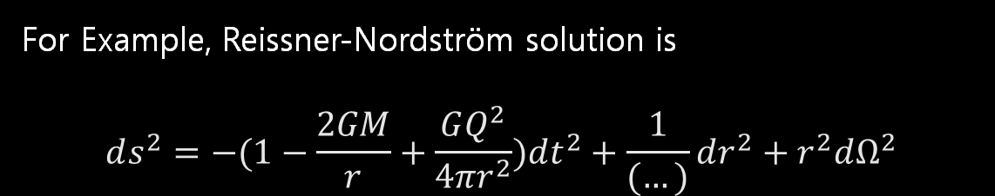
Background
The Einstein-Maxwell Field Equations describe the geometry of spacetime with charged matter (~point charge at origin)
$$F_{μν}=∂_{μ}A_{ν}−∂_{ν}A_{μ}$$
$$G_{μν}=κ(F_{μ}^{α}F_{να}−\frac{1}{4}F^{αβ}F_{αβ}g_{μν})$$
For Example, Reissner-Nordström solution is
$$ds^{2}=−(1−\frac{2GM}{r}+\frac{GQ^{2}}{{4πr}^{2}})dt^{2}+\frac{1}{(…)}dr^{2}+r^{2}dΩ^{2}$$

Slide 3
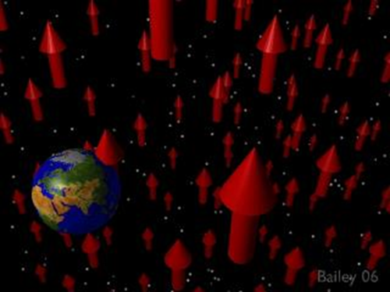
Background
There has been much work in last 25+ years on the possibility of spacetime-symmetry breaking
(could arise in quantum gravity, string field theory, NC spacetime, etc.)
Symmetry is described by background tensor fields
There are different types of symmetry breaking that could happen:
Spontaneous-symmetry breaking ( dynamical )
Explicit symmetry breaking ( a priori )
Kostelecky-Samuel PRL, PRD 89', Gambini-Pullin 99', Jacobson-Mattingly PRD 01', ...

Slide 4
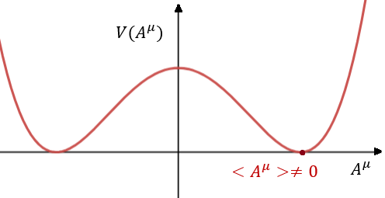

The Bumblebee Model
The Bumblebee Model generalizes the Einstein-Maxwell theory with a potential for the vector field causing spontaneous Lorentz-symmetry breaking
$$∇_{μ}F^{μν}=2V^{′}A^{ν}$$
$$G_{μν}=κ\left[\left(F_{μα}F_{ν}^{α}−\frac{1}{4}g_{μν}F^{2}\right)−Vg_{μν}+2V^{′}A_{μ}A_{ν}\right]$$
Kostelecky-Samuel PRL, PRD 89' +

Slide 5

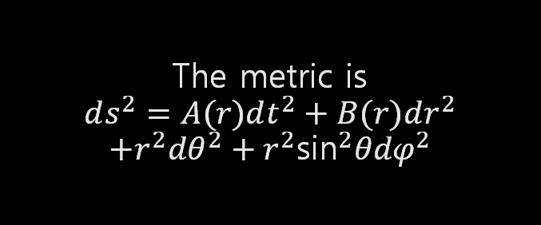
Spherically Symmetric Solutions
Preliminary goal of project
Assume spherical symmetry
$$B_{μ}={(B}_{0}\left(r\right),0,0,0)$$
The metric is
$$ds^{2}=A(r)dt^{2}+B(r)dr^{2}$$
$$+r^{2}dθ^{2}+r^{2}{\text{sin}}^{2}θdφ^{2}$$

Slide 6

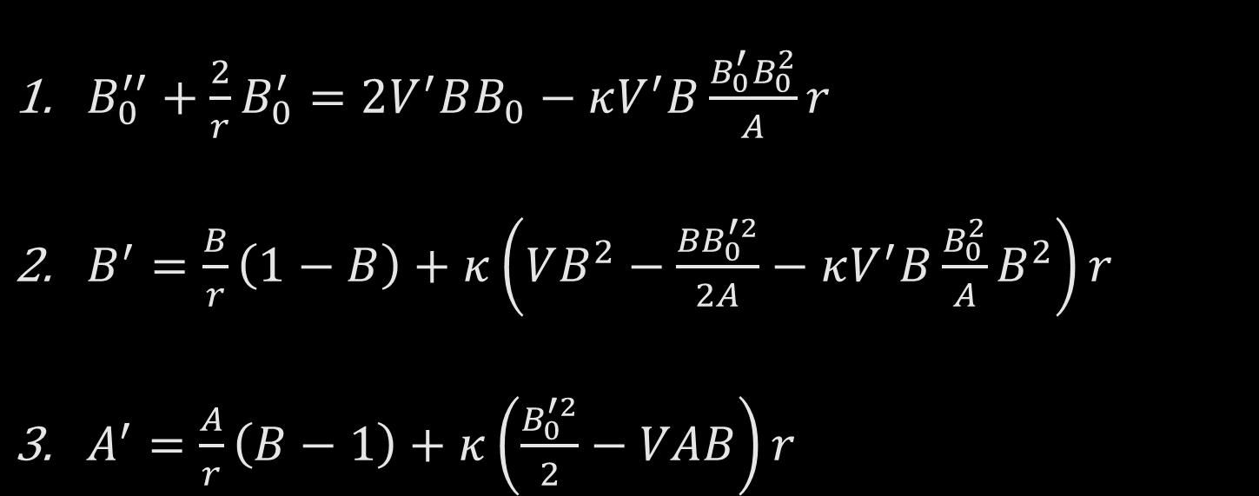
Coupled Equations for $B_{0}, A,$ and $B$
The following coupled differential equations for $B_{0}, A,$ and $B$ were found:
$B_{0}^{′′}+\frac{2}{r}B_{0}^{′}=2V^{′}BB_{0}−κV^{′}B\frac{B_{0}^{′}B_{0}^{2}}{A}r$
$B^{′}=\frac{B}{r}\left(1−B\right)+κ\left(VB^{2}−\frac{{BB}_{0}^{′2}}{2A}−κV^{′}B\frac{B_{0}^{2}}{A}B^{2}\right)r$
$A^{′}=\frac{A}{r}\left(B−1\right)+κ\left(\frac{B_{0}^{′2}}{2}−VAB\right)r$

Slide 7
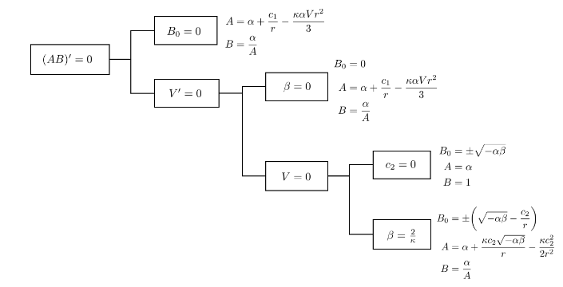
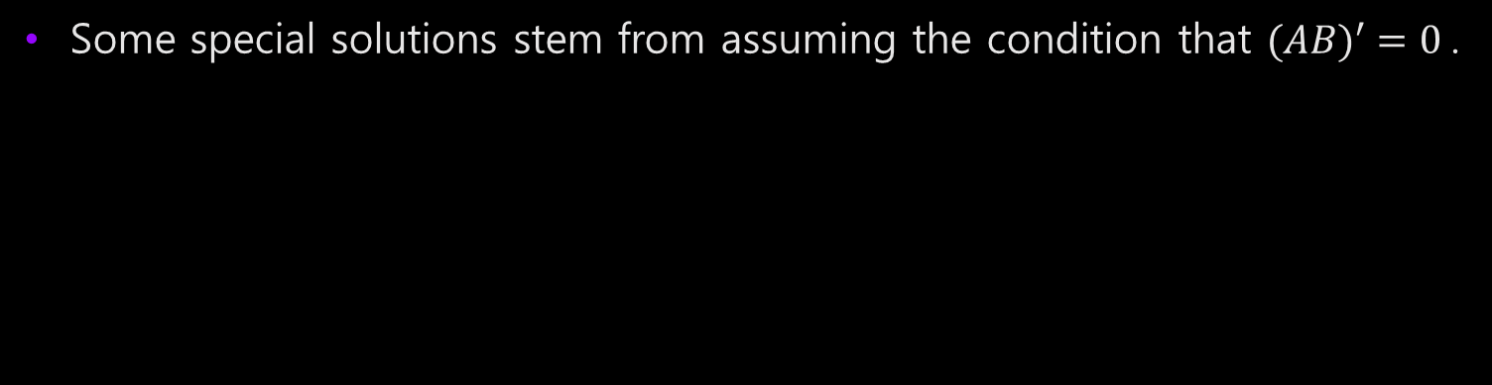
Specialized Exact Solutions
Some special solutions stem from assuming the condition that ${(AB)}^{′} =0$.

Slide 8
Photon Trajectories
We can use numerical solutions of the field equations along with the geodesic equation to find the trajectory of photons around the black hole.
We will show a preliminary investigation with several choices of initial conditions

Slide 9
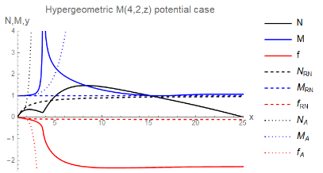
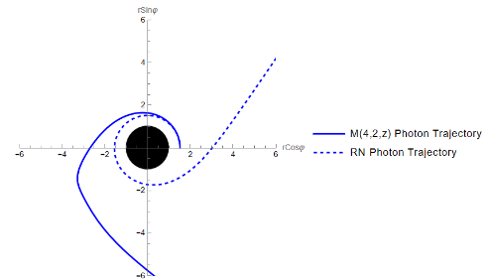
Photon Trajectories
Note: N and M are analogues of A and B from the metric

Slide 10
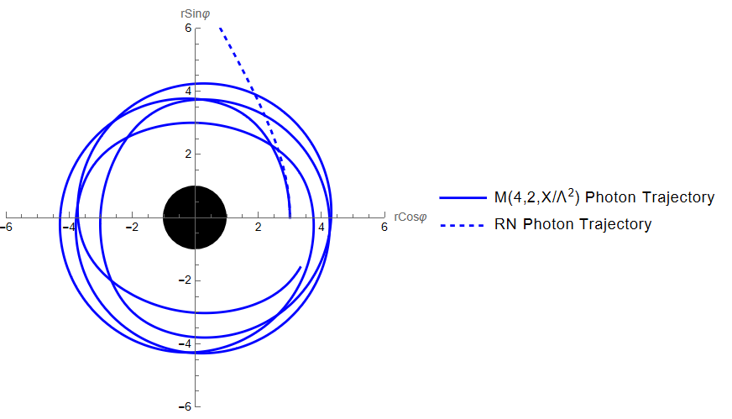
Photon Trajectories
Note: N and M are analogues of A and B from the metric

Slide 11
Summary
Investigating a model of spontaneous Lorentz symmetry breaking
Seek spherical symmetric solutions
Include the effects of the potential term
We examine some specialized exact solutions
Begin investigation into trajectories of photons around the black hole in GR and modified spacetime
The paper is on ArXiv: 2503.10998

